Slide 1
APPLYING FOR SHOWS

Slide 2
AGENDA
Finding shows
Selecting work for the application
Photographing
Editing photos
Questions

Slide 3
FINDING SHOWS

Slide 4
FIND OPPORTUNITIES ONLINE
SUGGESTIONS
The Clay Studio
Companion Gallery
Saratoga Clay Arts Center
Clay Art Center
Workhouse Arts Center
CERAMICS MONTHLY
GOOGLE!
FOLLOW STUDIOS & GALLERIES ON INSTAGRAM
Call for entry website

Slide 5
SELECTING WORK
Curating a cohesive body of work

Slide 6
PICK THREE PIECES TO PRESENT
1
2
3
4
5
6
7
8

Slide 7
PIECES TO PRESENT
2
3
6
These three have a similar style while also having unique qualities from each other - adding to the visual interest

Slide 8
PHOTOGRAPHING WORK
Presenting your work through digital photos

Slide 9
CONSIDERATIONS
PHOTOGRAPH YOUR WORK USING A NEUTRAL, SMOOTH BACKGROUND
LEAVE OUT CLUTTER
MAKE SURE YOUR WORK IS WELL LIT
CROP THE IMAGE SO THE PIECE TAKES UP MOST OF THE PHOTO
PHOTOS CUTE FOR INSTAGRAM MIGHT NOT BE APPROPRIATE FOR SHOW APPLICATIONS
WORK IS SHOW AT AN ANGLE THAT SHOWS THE OPENING OF THE PIECE
ITEMS CAN CLEARLY BE SEEN

Slide 10
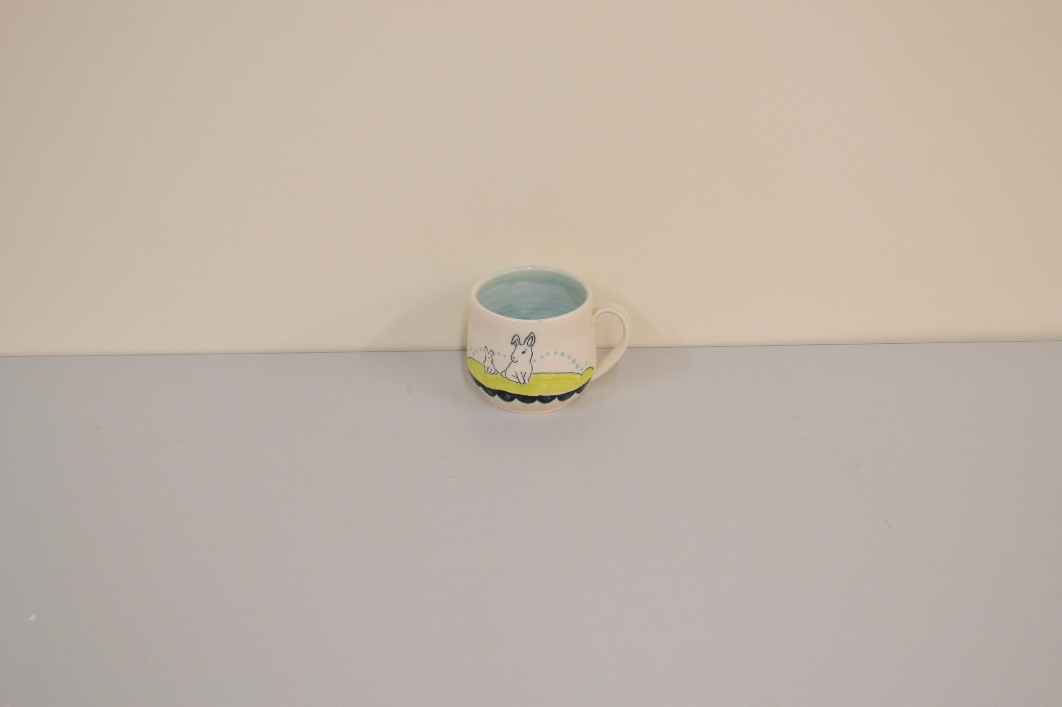
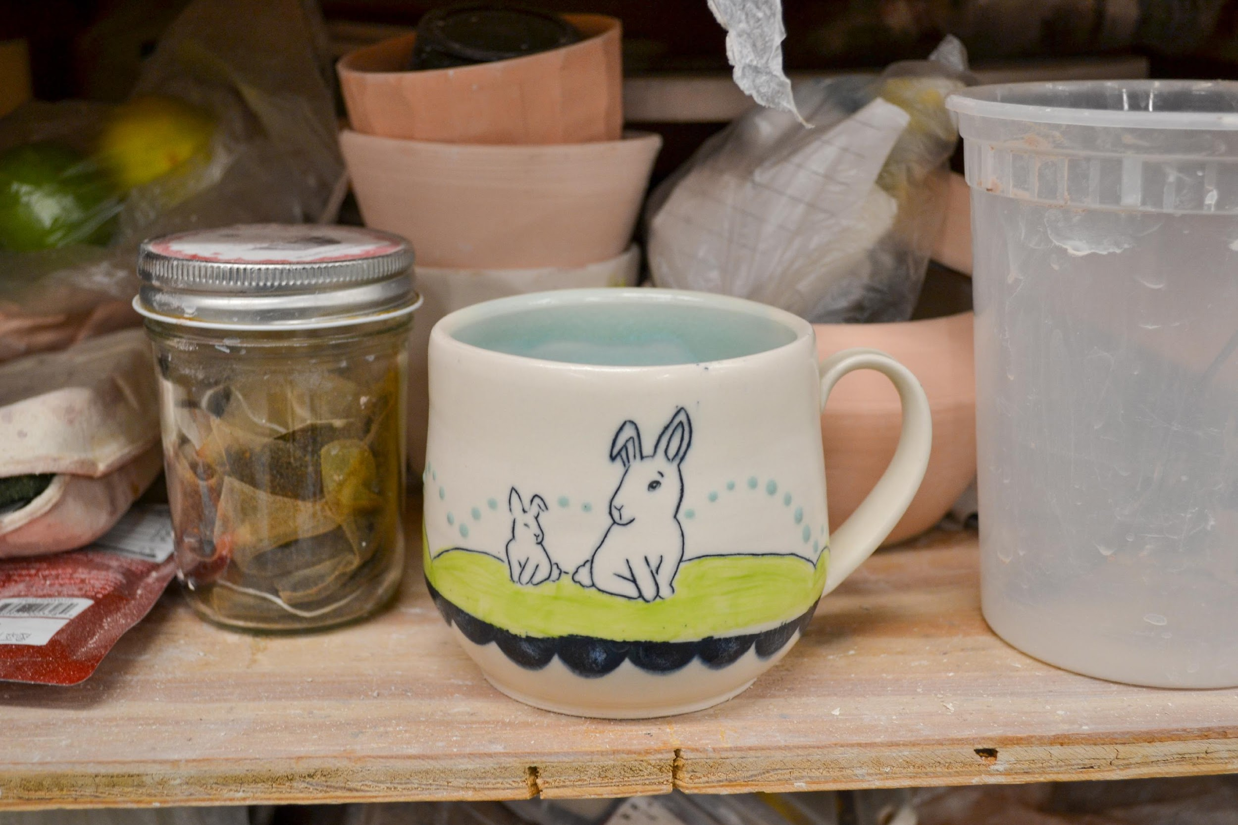
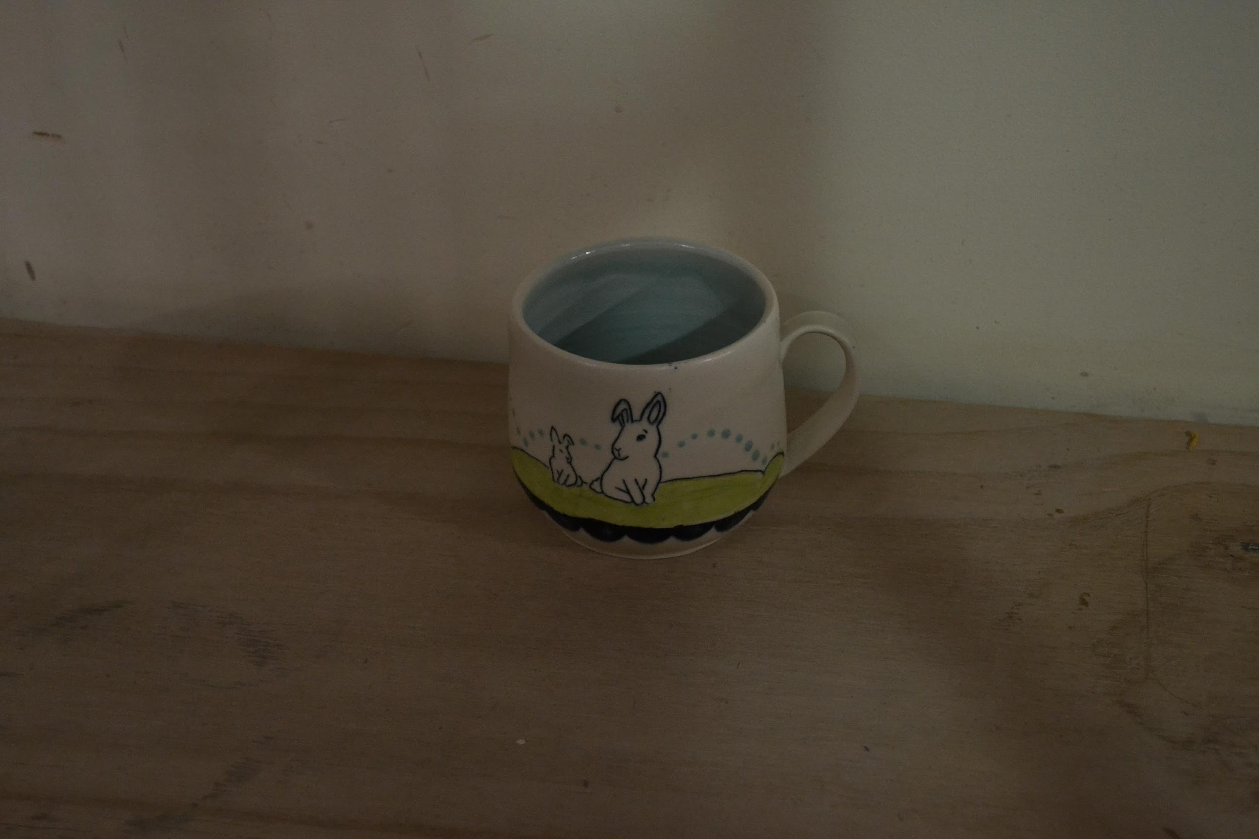
PHOTO EXAMPLES
TOO FAR
CLUTTERED PHOTO
TOO DARK
The details of the work get lost when the image is too far away- instead crop the photo to better view the piece
Photos with too much extra “stuff” can be distracting to the juror
Be sure to properly light the work when photographing.

Slide 11
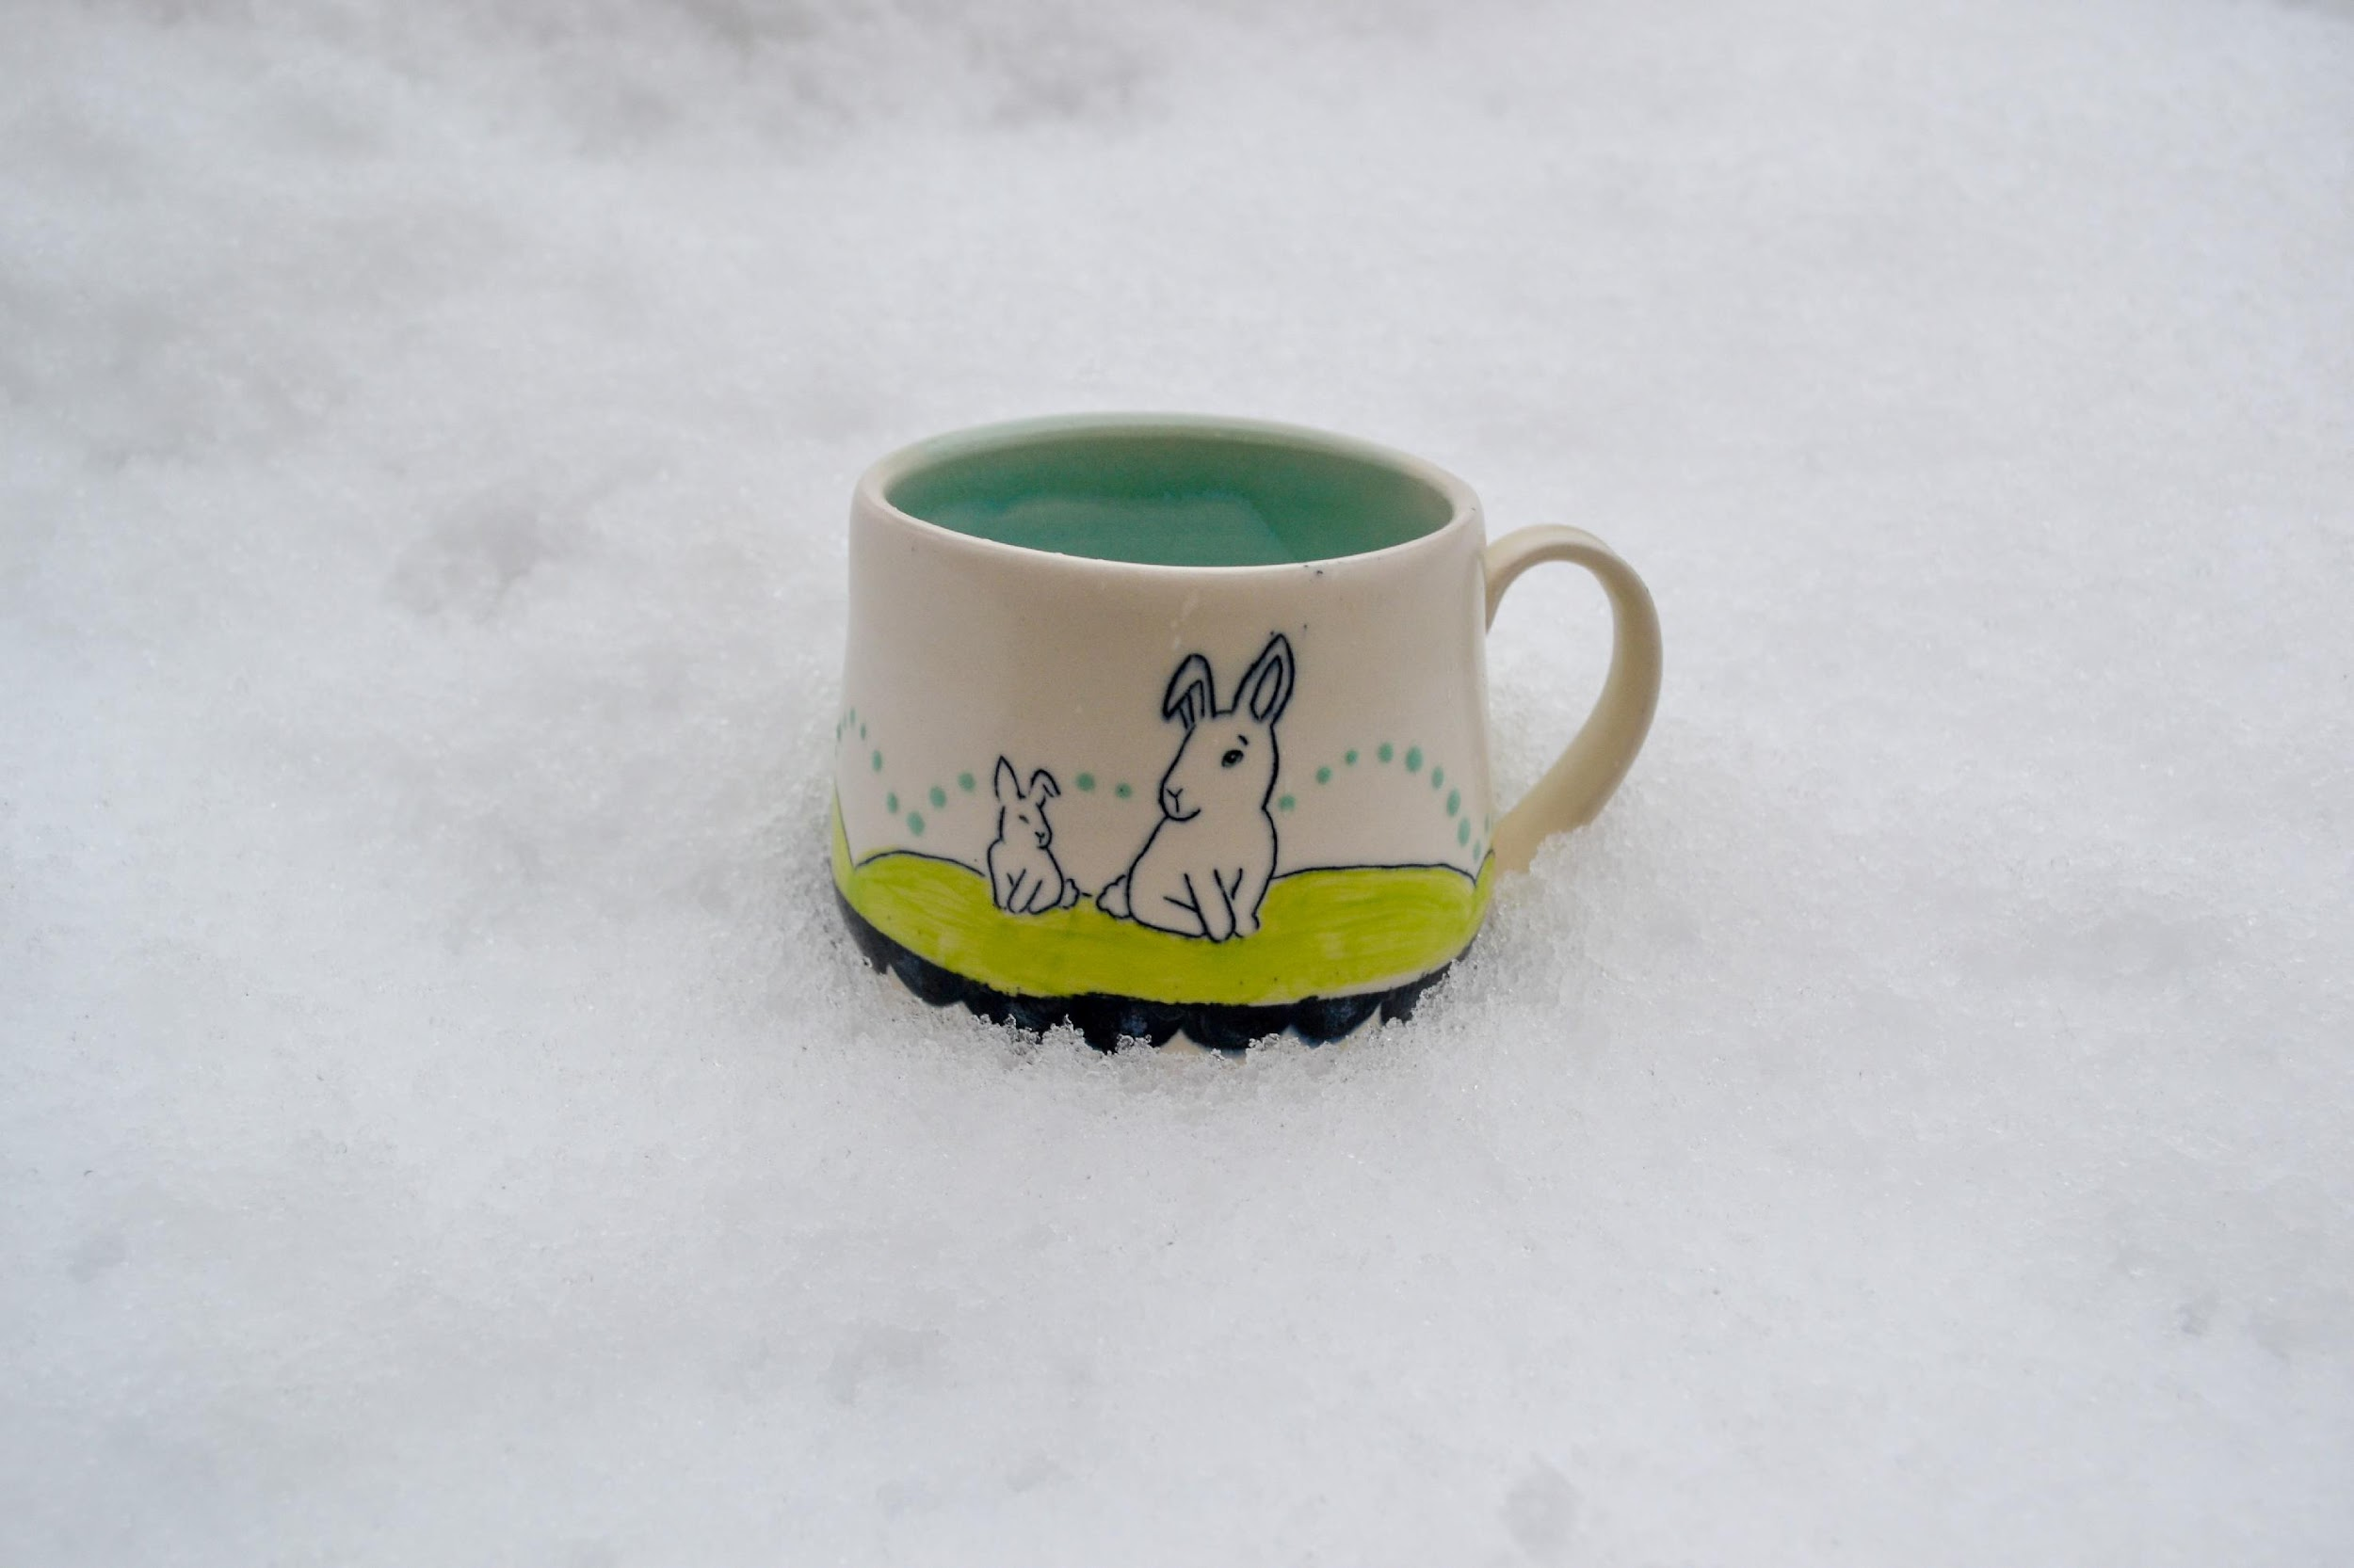
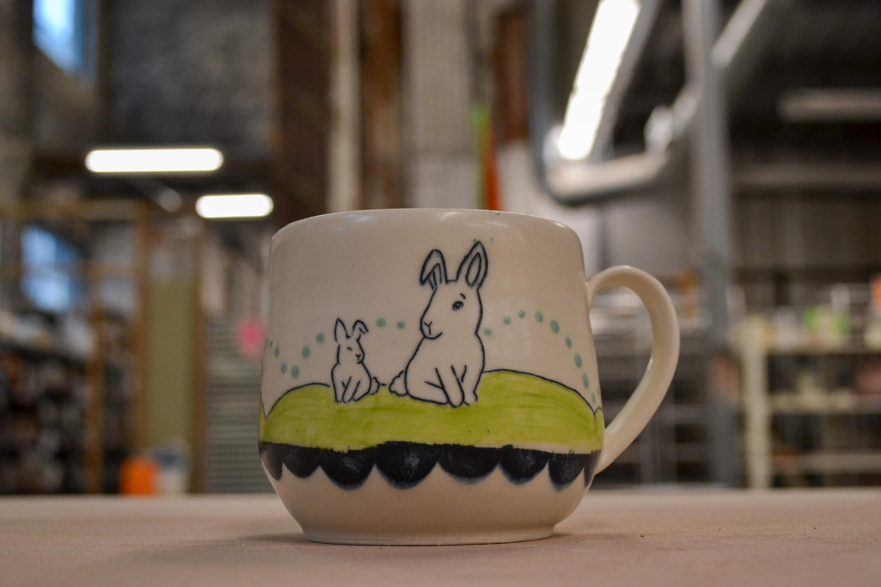
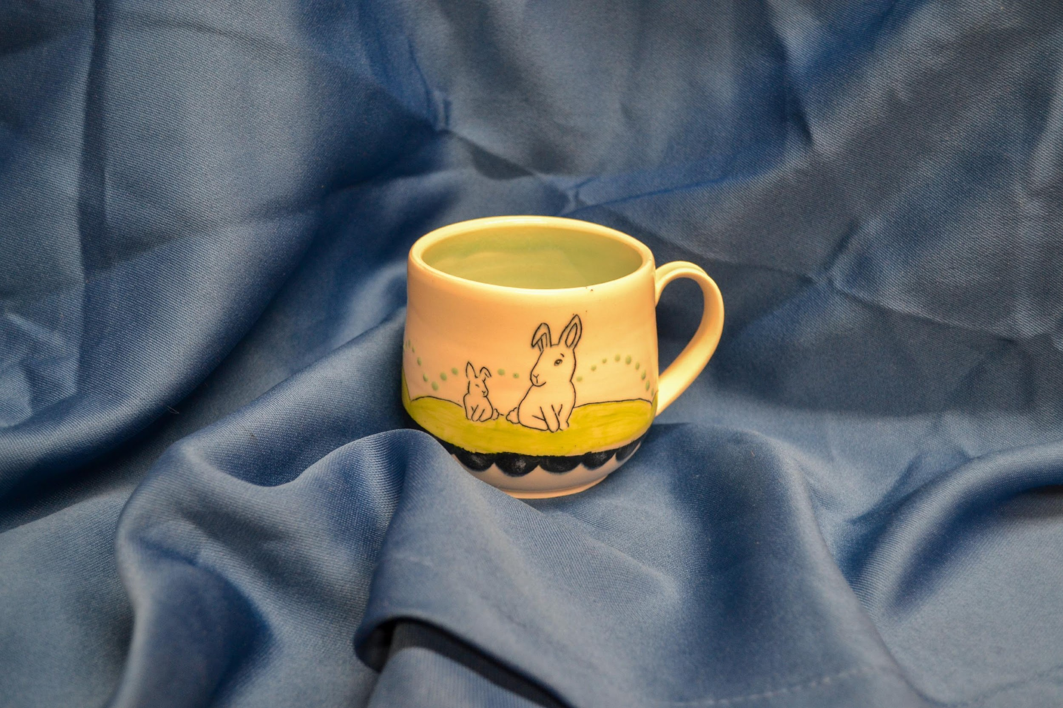
PHOTO EXAMPLES
INSTA-CUTIE, NOT APPLICATION
TOUGH ANGLE
DISTRACTING BACKGROUND
We want to show the view this is a 3-D object that has an opening. Adjust the angle to give a hint of the opening to portray this. This background is also a bit distracting.
This is a super cute social media post, but doesn’t give the viewer the best view of the work
While this background is neutral, the folding, bunching and wrinkling can be a distraction.

Slide 12
CREATING A PHOTO SET UP

Slide 13
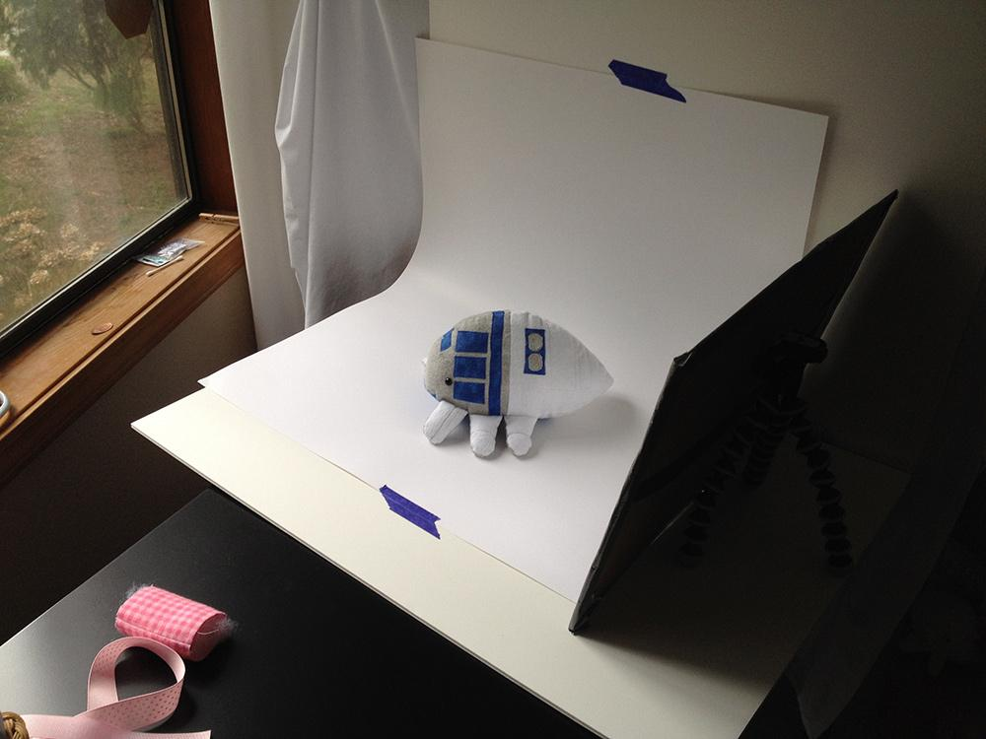
USING A WINDOW
Tape a poster board on the wall so it forms a gentle curve
Use a window as a light source- overcast days are perfect for diffused light
Add a reflector- this can be as simple as tin foil wrapped around some cardboard

Slide 14
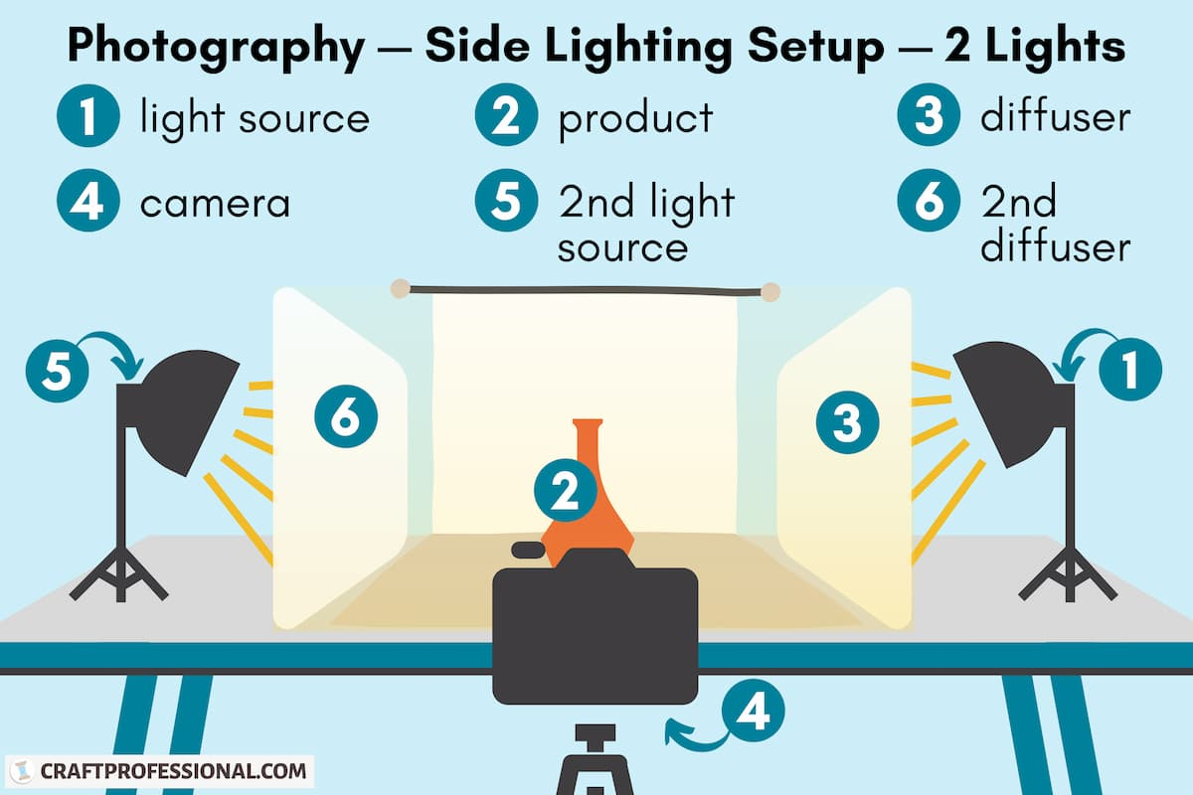
USING LIGHTS
Desk lamps work great!
Diffusers can be something you have at home! A white tee wrapped around a frame, craft form, etc.

Slide 15
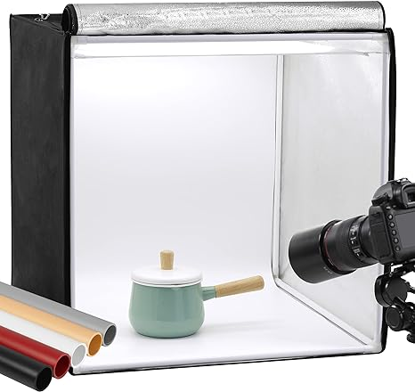
PHOTO BOOTH KITS
Photo booth kits can be purchased online
Many of them come with lights or have lights connected like this one
They range in price from $30- $200
They are often on the smaller side, not great for photographing larger pieces.

Slide 16
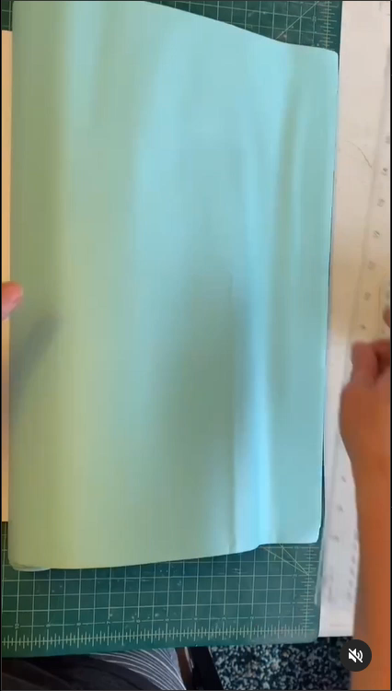
DIY FROM CHANDRA DEBUSE
Just another option! This is from the Instagram of Chandra DeBuse on DIYing colorful, interchangeable backgrounds
Follow her @chandradebuse

Slide 17
EDITING YOUR PHOTOS

Slide 18
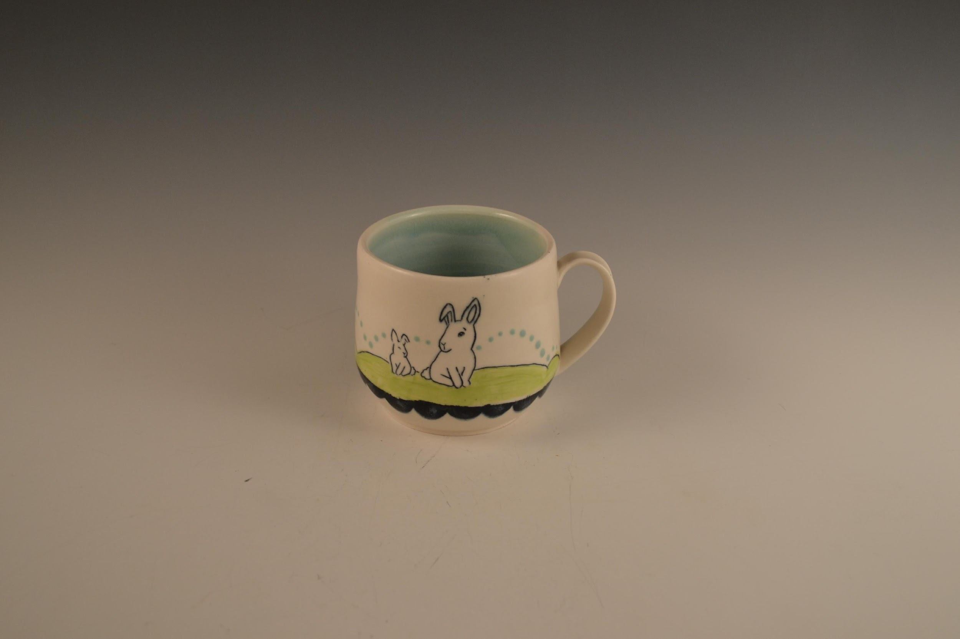
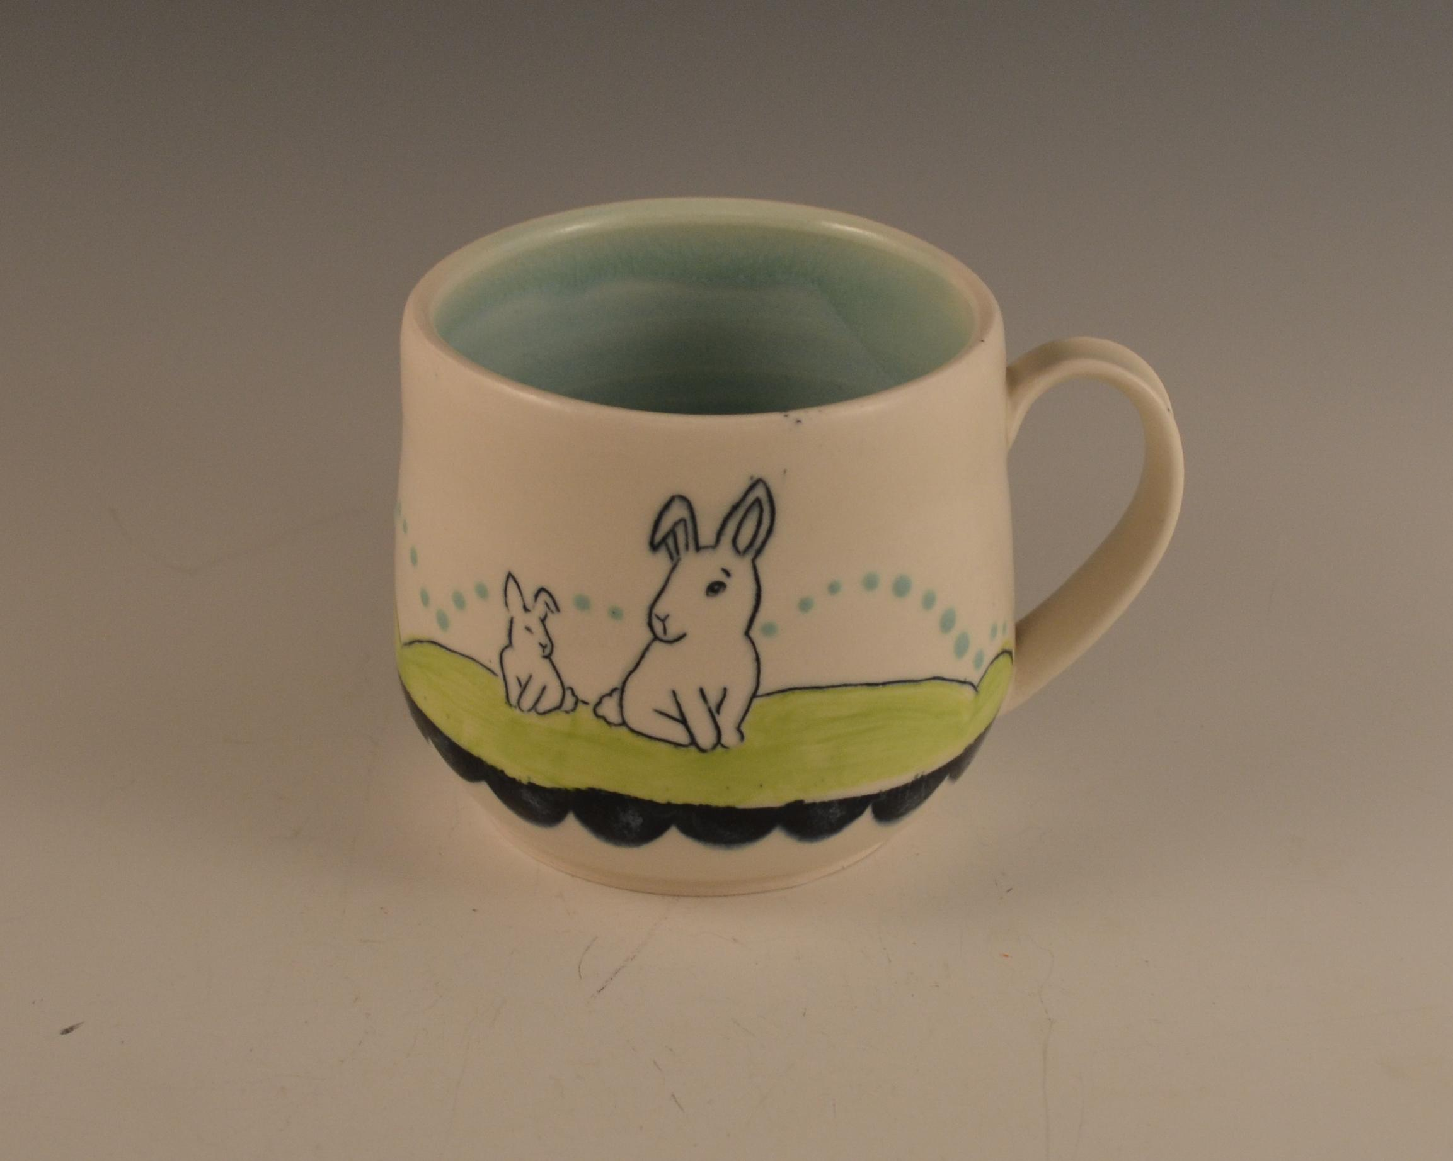
CROPPING
BEFORE
AFTER
By cropping the photo, the view can better see what is happening in the work. There is still “breathing room” around the piece, but less empty space.
Think of it as moving your piece from an ocean to a lake.
There is a lot of blank space around the work. Much of the detail can get lost and has less visual interest to the viewer.

Slide 19
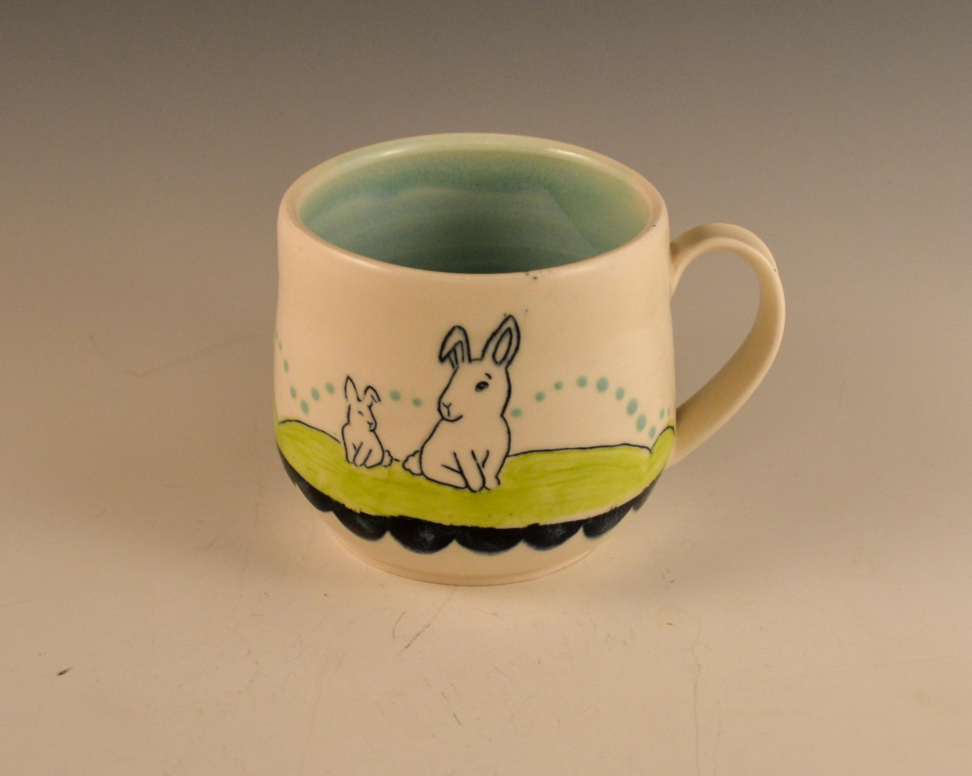
BRIGHTNESS
BEFORE
AFTER
This photo jumps out more & is more clear after making these adjustments.
The photo is a little dark. By adjusting the brightness and exposure we can enhance this photo to give it more “pop”

Slide 20
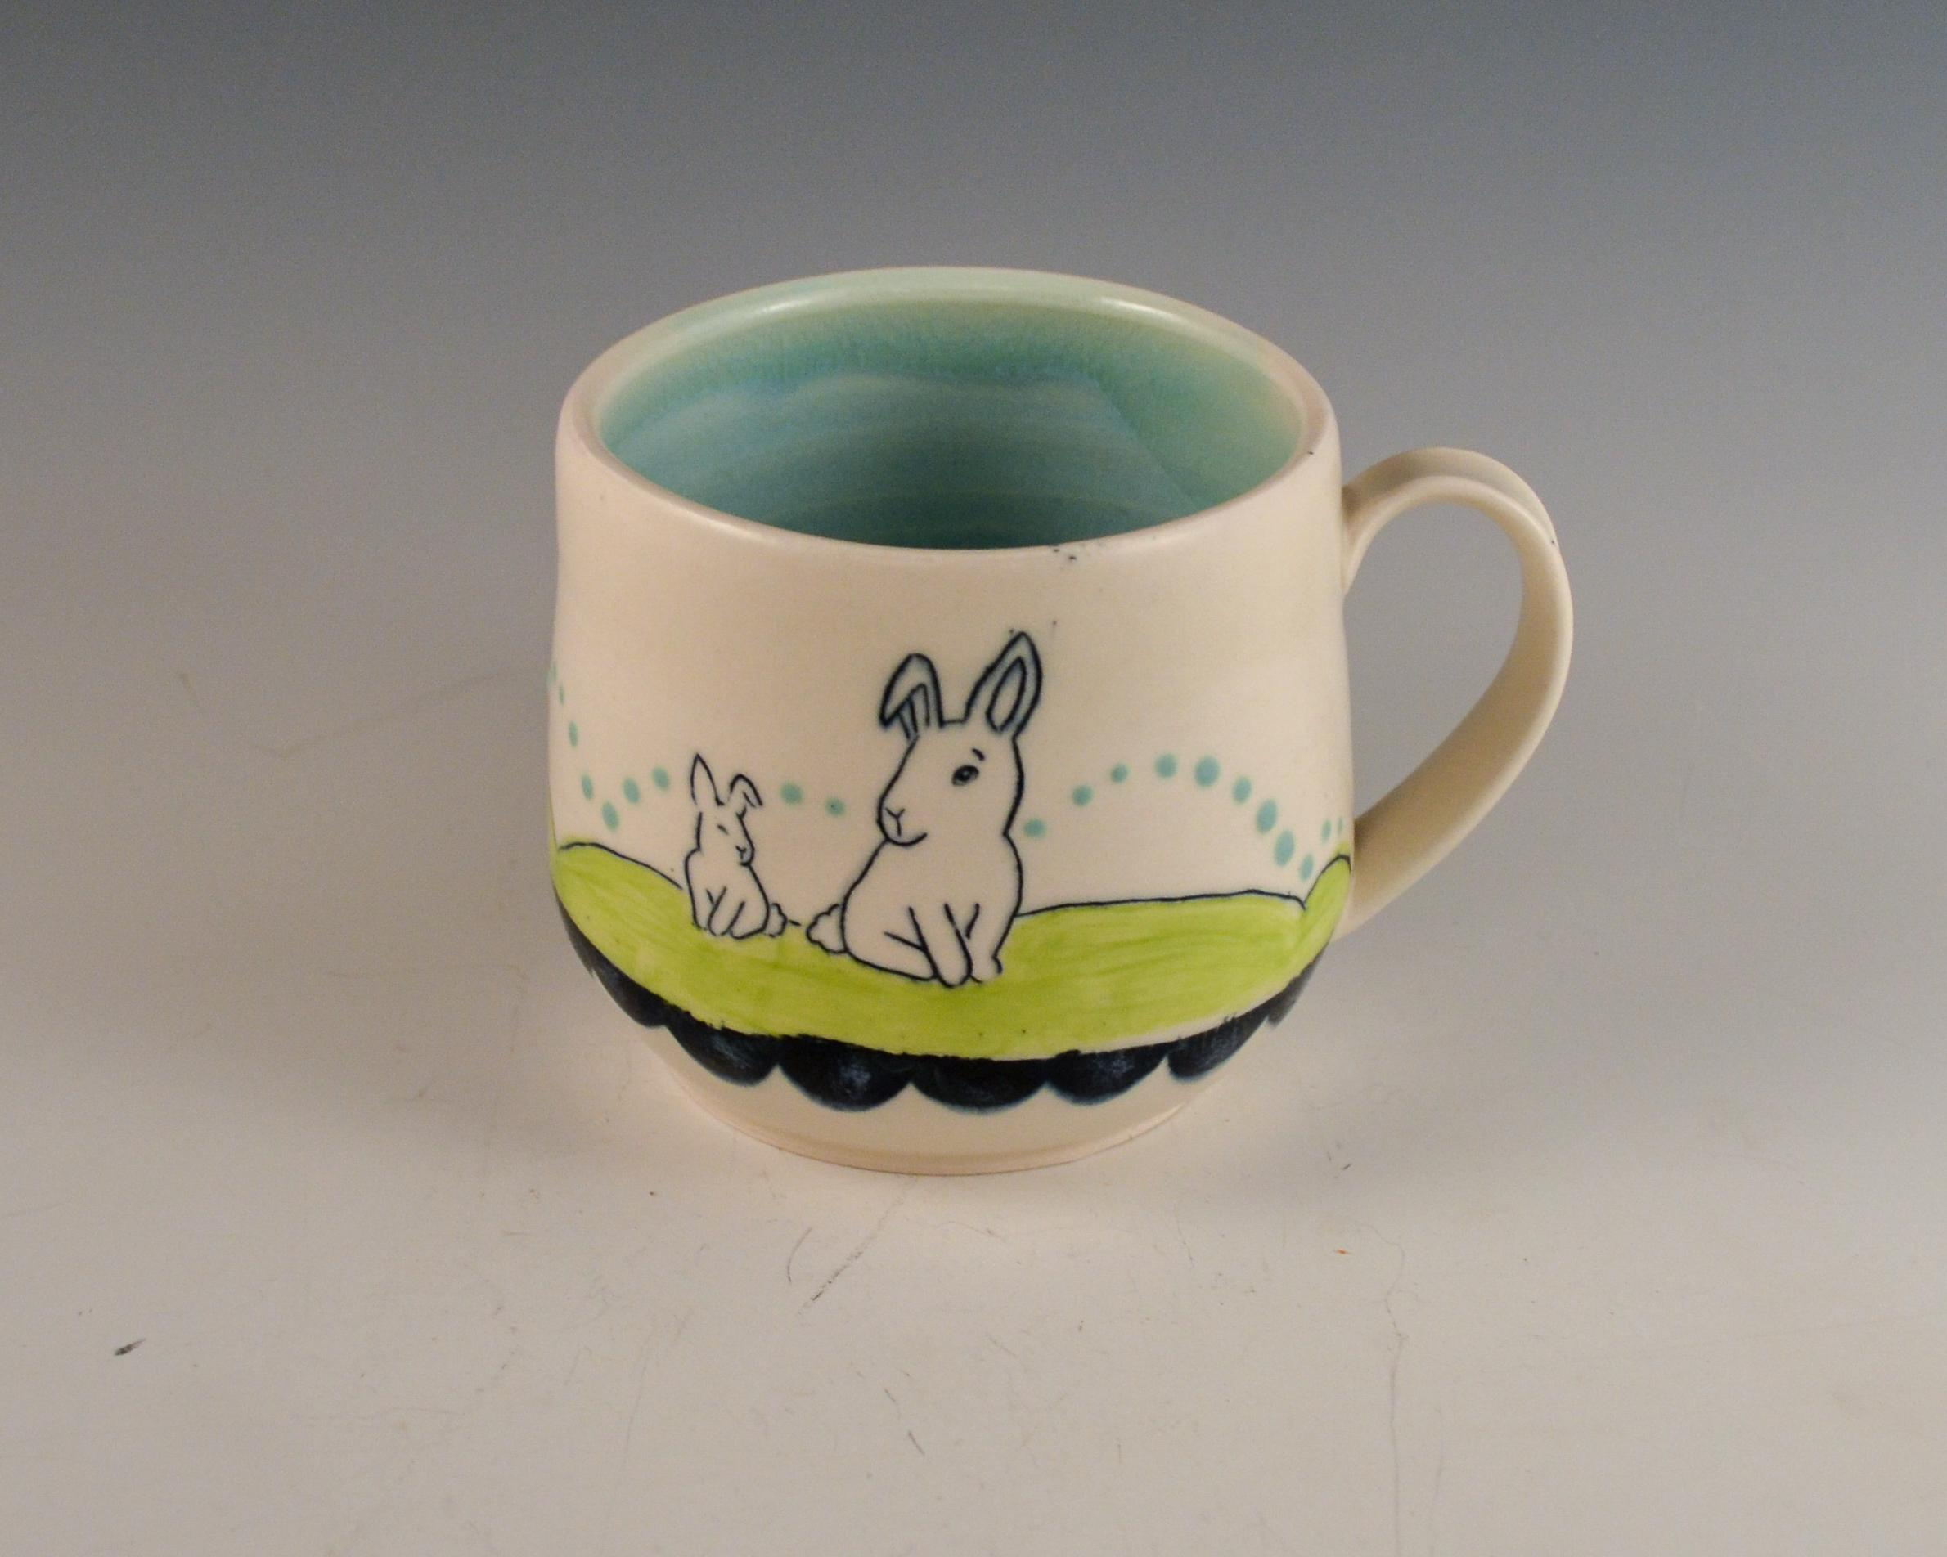
WHITE BALANCE
BEFORE
AFTER
Editing the white balance- adjusting it by making it cooler, make the image look more true to life giving better representation of the work.
The color of the clay and background is not true to life- it is very warm.

Slide 21
STARTING IMAGE
FINISHED IMAGE

Slide 22
QUESTIONS?

Slide 23
GOOD LUCK APPLYING!
Thank you!

